Slide 1
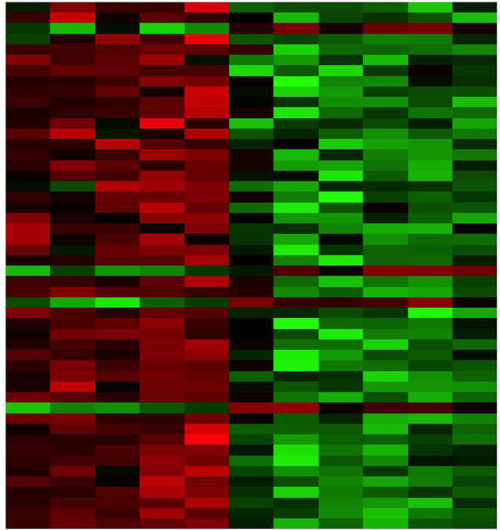

RNA-seq differential expression analysis part 1 Egypt Scholars
Mariam Oweda Kamel
Nile University, Egypt
Day/Month/2016
“DAR Weekly Webinar”

Slide 2

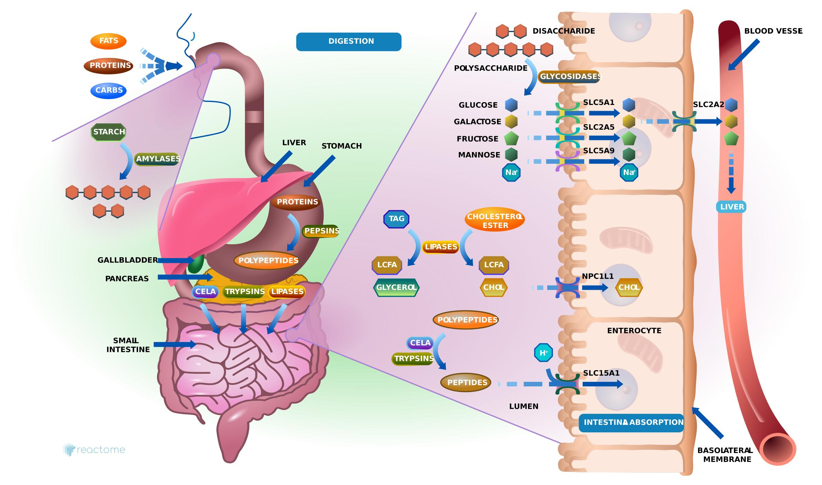

What is human ?

Slide 3
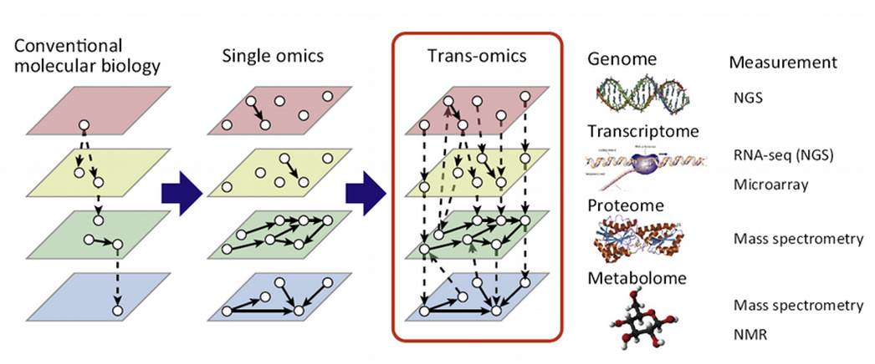
science of omics

Slide 4









What is gene expression?

Slide 5
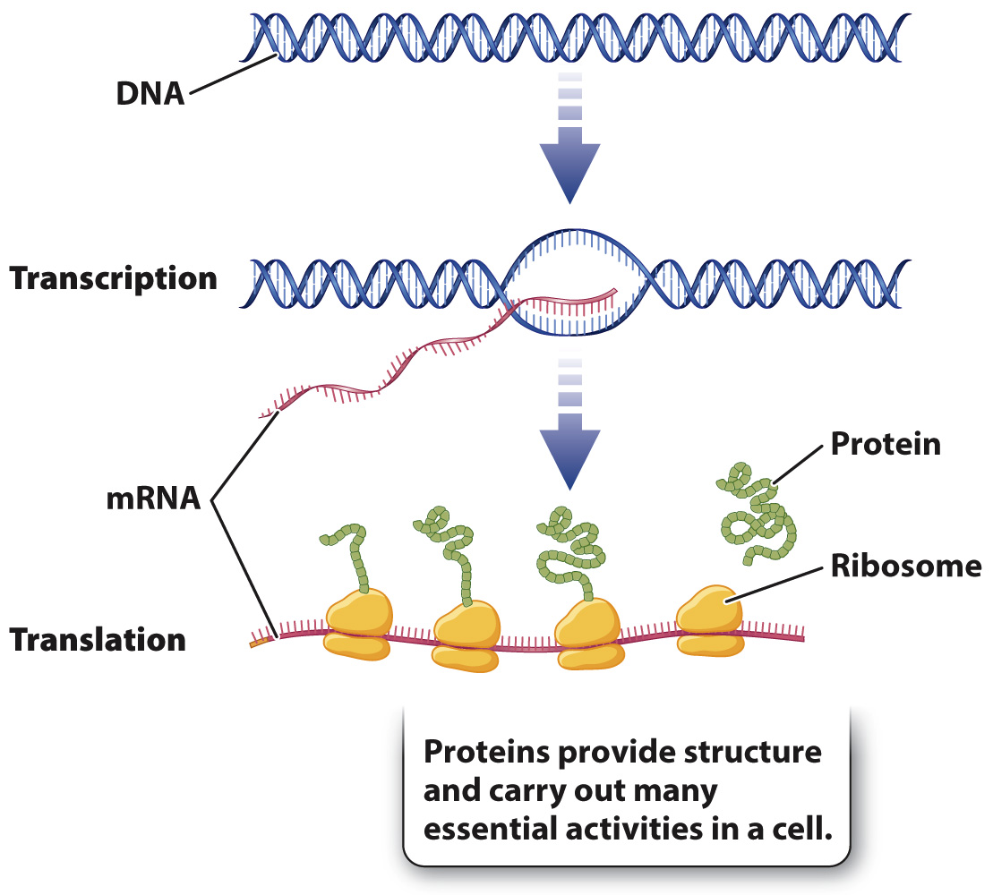
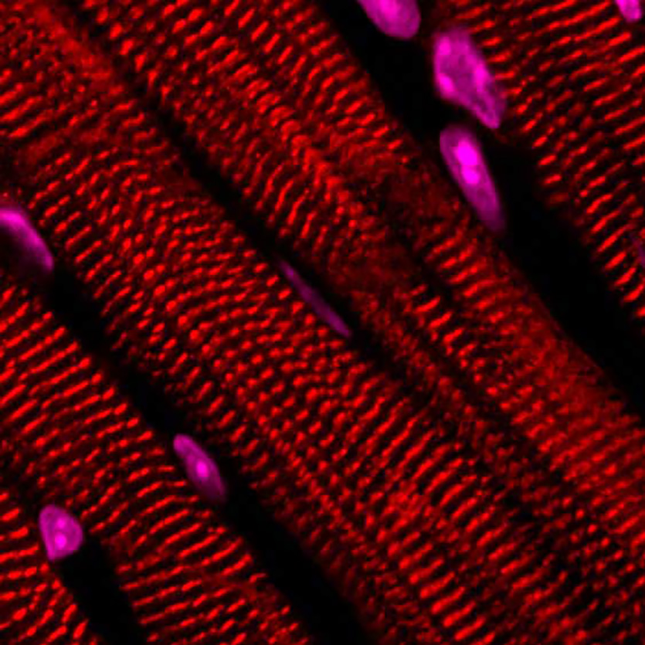


What is gene expression?
The central dogma
DNA
Gene A
Gene B
Gene C

Slide 6
What is gene expression?
DNA
Gene A
Gene B
Gene C
mRNA
Protein

Slide 7
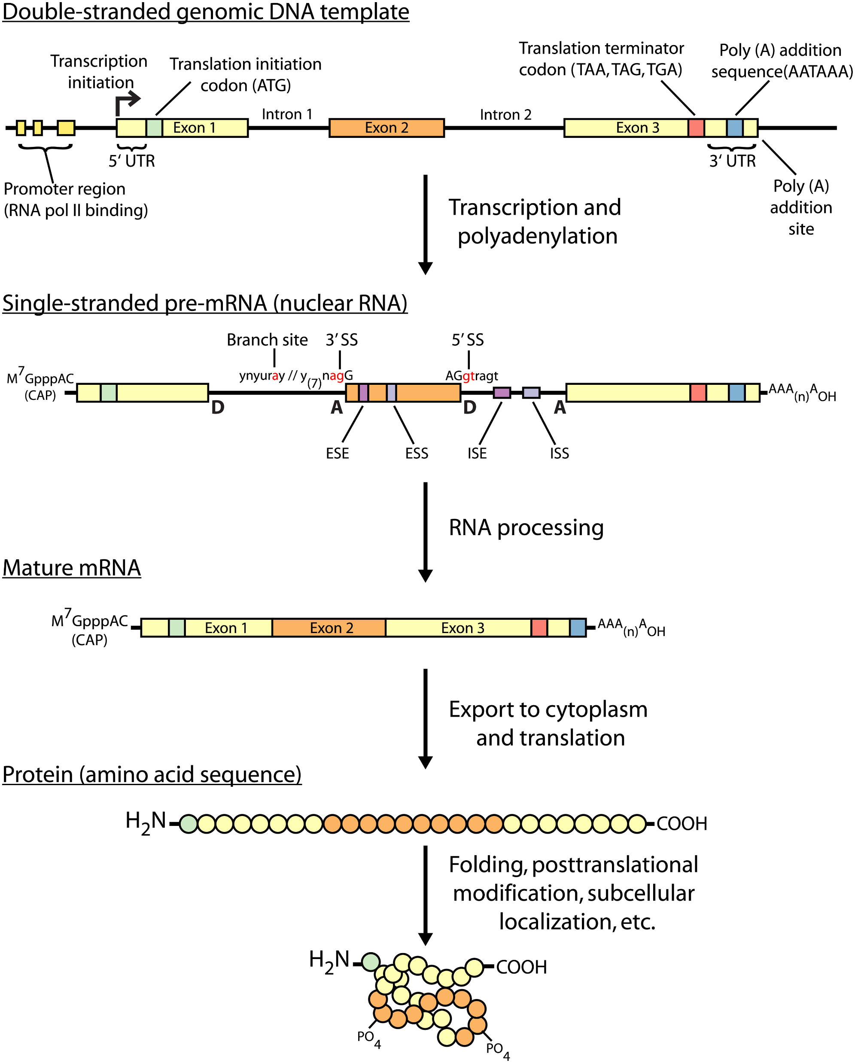
What is gene expression?

Slide 8
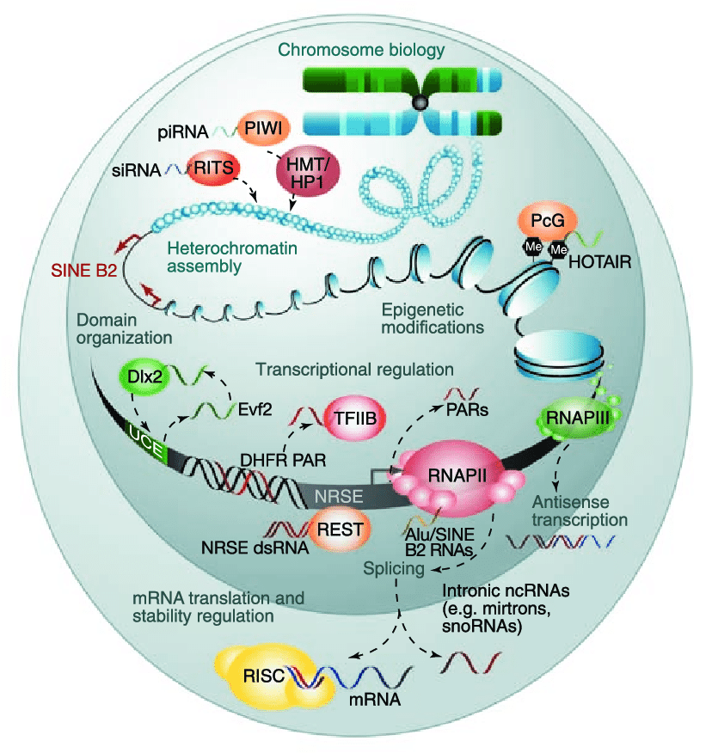
What is gene expression?

Slide 9
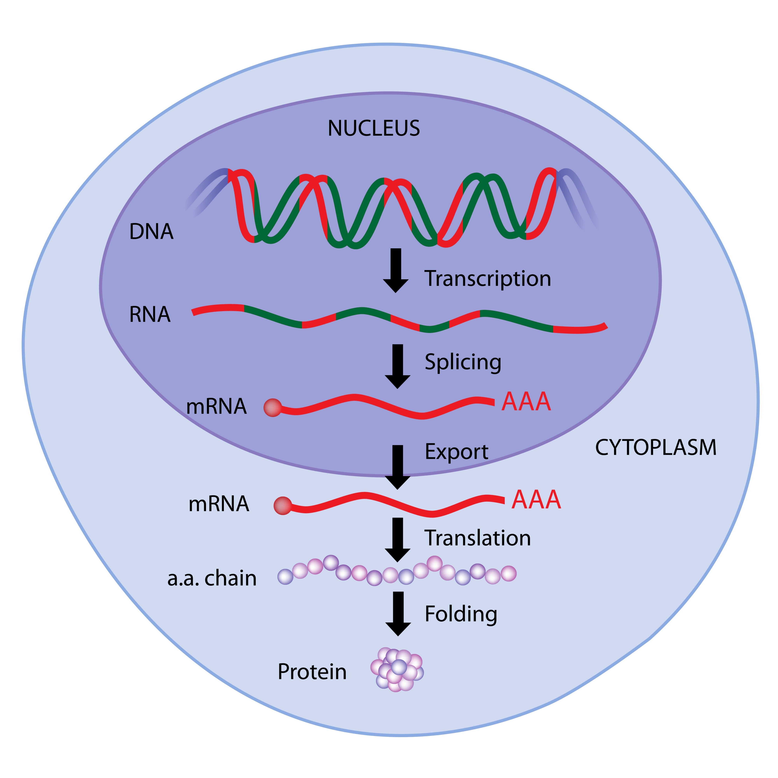
What is gene expression?

Slide 10

Transcriptome profile
The transcriptome is the total set of transcripts or mRNA molecules expressed in a cell at specific time (snapshot of the cell), different cells show different patterns of gene expression. These differences are responsible for the many different properties and behaviors of various cells and tissues, both in health and disease.

Slide 11
Why sequence RNA (versus DNA)?
1- Functional studies
– Genome may be constant but an experimental condition has a pronounced effect on gene expression (differential expression)
• e.g. Drug treated vs. untreated cell line
• e.g. Wild type versus knock out mice
2- Predicting transcript sequence from genome sequence is difficult
3- Some molecular features can only be observed at the RNA level
– Alternative isoforms, fusion transcripts, RNA editing
4- Understand allele specific expression

Slide 12

differential gene expression analysis?!! Why?
The goal of differential expression analysis is to identify genes whose expression level differs under different conditions using statistical analysis to discover quantitative changes in the expression levels.

Slide 13
differential gene expression analysis?!! Why?
which genes are expressed at different levels and reasonable for the disease ?
What are the differentially expressed genes?
Gene A is up regulated
Gene c is down regulated
Gene D is turned off
Gene L is turned on
vs
Normal cell
Tumor cell
Gene A
Gene C
Gene A
Gene C
Gene B
Gene B
Gene D
Gene L

Slide 14
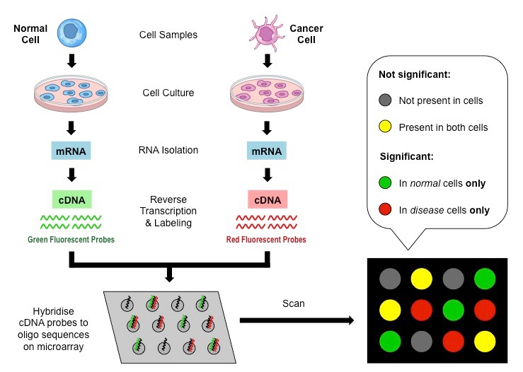
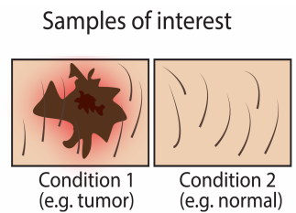
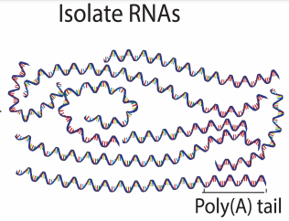
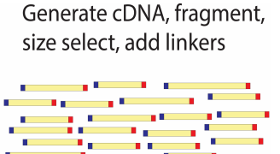
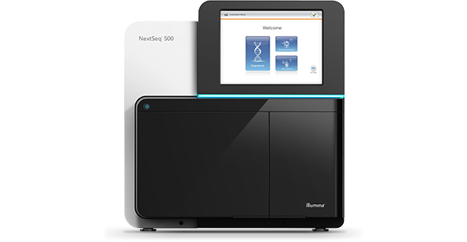
Gene Expression Profiling Technologies
Microarray
RNA-seq
Sequencer

Slide 15






RNA-seq experiment overview
Biological samples preparation
Biological replicates
Healthy
Cancer
mRNA isolation?

Slide 16
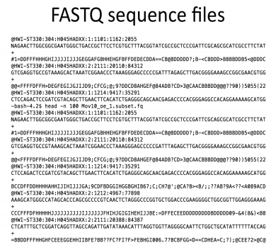
RNA-seq experiment overview
Library preparation
mRNA
mRNA fragmentation
Reverse transcription to cDNA
Adaptors ligation
High throughput sequencer

Slide 17
Problems in the sequence
Low confidence bases, Ns.
Sequence specific bias, GC bias
Adaptors
Sequence contamination

Slide 18
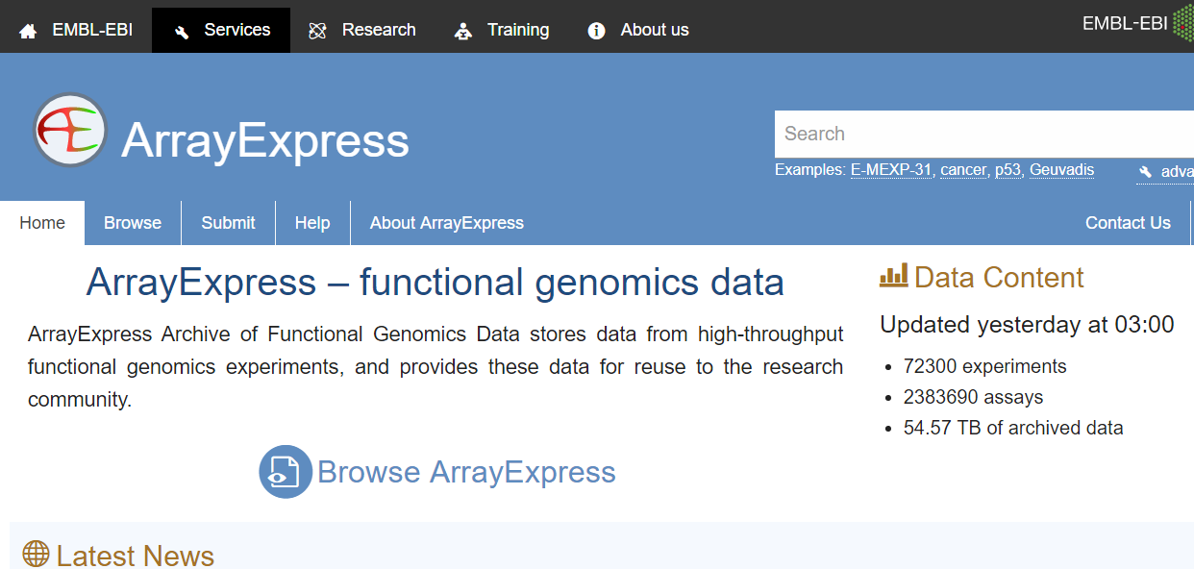
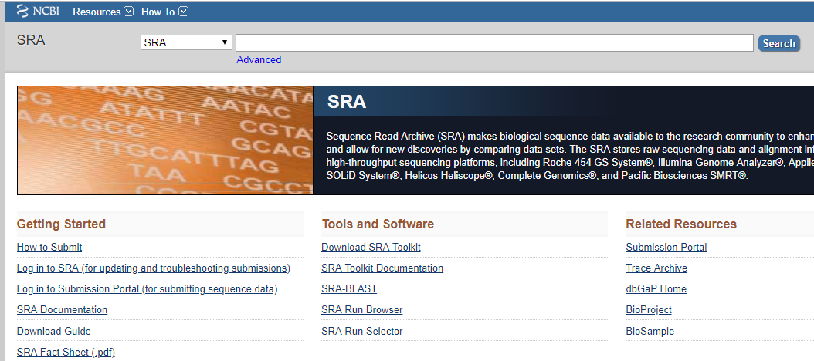
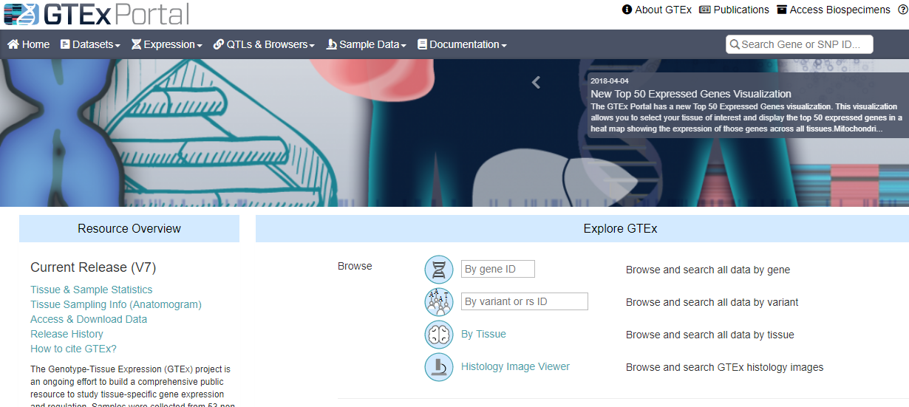
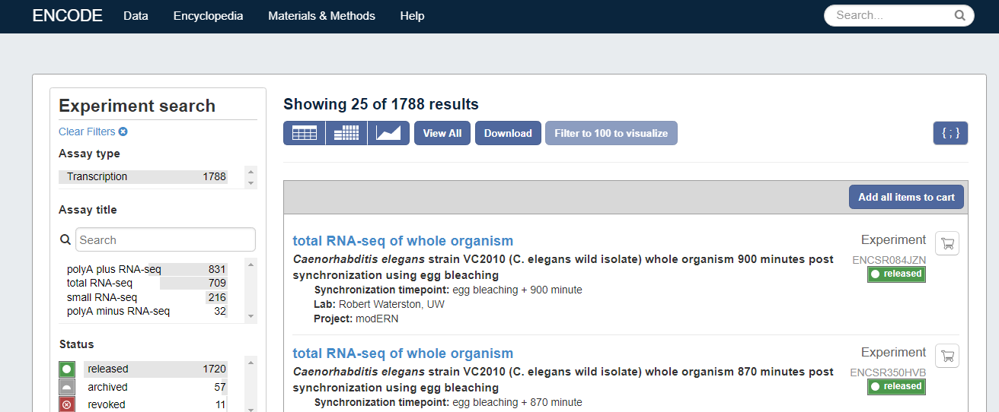
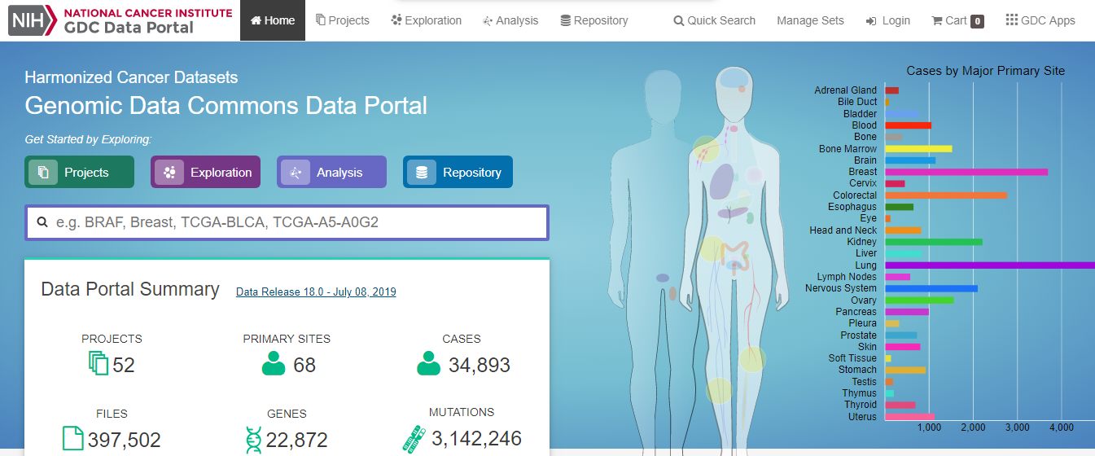
RNA-seq Datasets

Slide 19
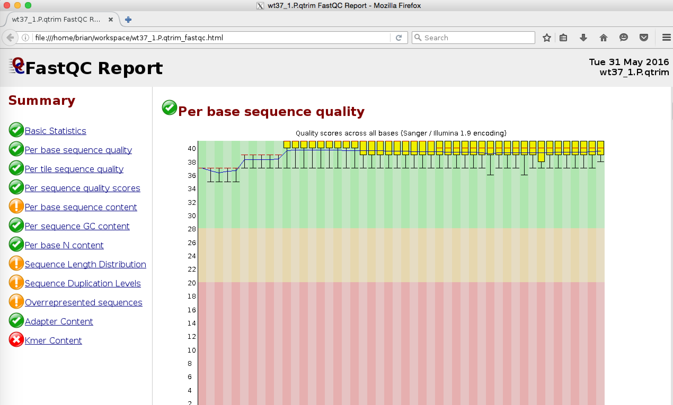

RNA-seq differential expression workflow
RNA-seq short reads
Quality control (FastQC)
reference genome sequences (FASTA files)
Reads mapping to the genome
(STAR, GSNAP, TopHat)
annotations (GTF file)
FASTQ sequence reads

Slide 20
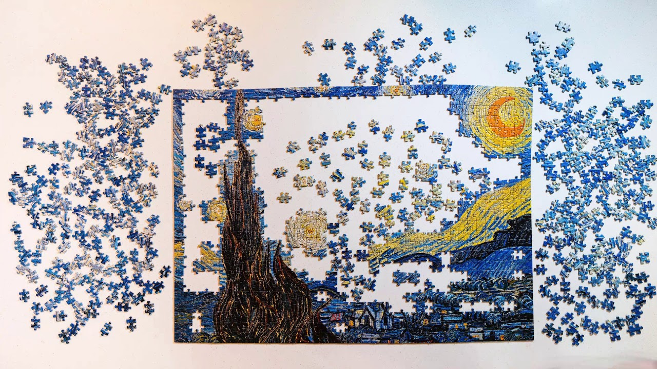

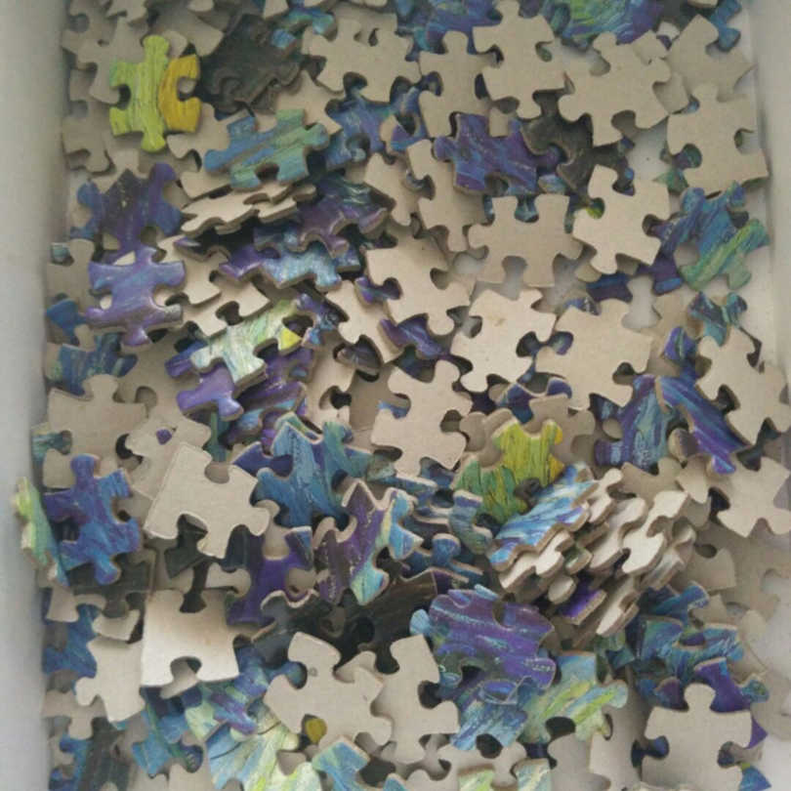
RNA-seq differential expression workflow
Reference
fragments

Slide 21
RNA-seq differential expression workflow
RNA-seq short reads
Quality control (FastQC)
reference genome sequences (FASTA files)
Reads mapping to the genome
(STAR, GSNAP, TopHat)
annotations (GTF file)
FASTQ sequence reads
Reference genome
ATCGGACGTAGCACCTAGTTCCAGGTATGCCCTTGG
Reference genome + Annotation file
Gene 1
Gene 2
Gene 3
Gene 4
Sample 1
Sample 2

Slide 22
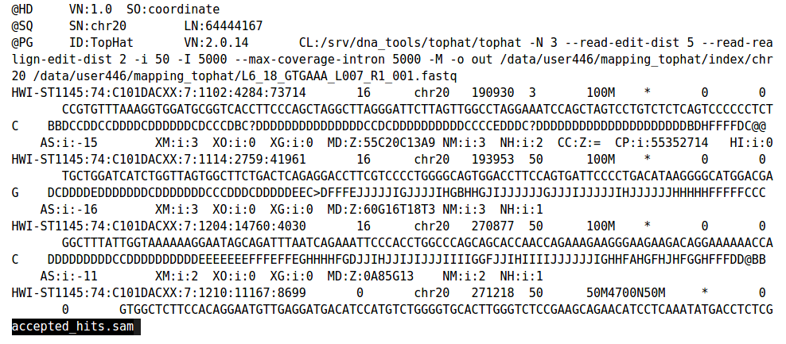
RNA-seq differential expression workflow
RNA-seq short reads
Quality control (FastQC)
reference genome sequences (FASTA files)
Reads mapping to the genome
(STAR, GSNAP, TopHat)
SAM file
annotations (GTF file)
FASTQ sequence reads
Counting reads associated with genes (HTSeq, featurecounts)
Reference genome
ATCGGACGTAGCACCTAGTTCCAGGTATGCCCTTGG
Reference genome + Annotation file
Gene 1
Gene 2
Gene 3
Gene 4
Sample 1
Sample 2

Slide 23
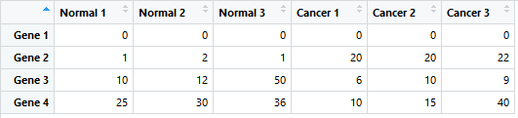
RNA-seq differential expression workflow
Reference genome
ATCGGACGTAGCACCTAGTTCCAGGTATGCCCTTGG
Reference genome + Annotation file
Gene 1
Gene 2
Gene 3
Gene 4
Sample 1
Count matrix
Sample 2

Slide 24
RNA-seq differential expression workflow
RNA-seq short reads
Quality control (FastQC)
reference genome sequences (FASTA files)
Reads mapping to the genome
(STAR, GSNAP, TopHat)
SAM file
annotations (GTF file)
FASTQ sequence reads
DESeq2 is a R/Bioconductor package for differential gene expression analysis on count based expression datasets using the negative binomial distribution.
Counting reads associated with genes (HTSeq, featurecounts)
Statistical analysis to identify the differentially expressed genes (DESeq2, limma, edgeR)

Slide 25

hank you

